Slide 1
Performance Metrics for Machine Translation model
NLP COE Internal updates
3/22/2022
Meet Paradia

Slide 2
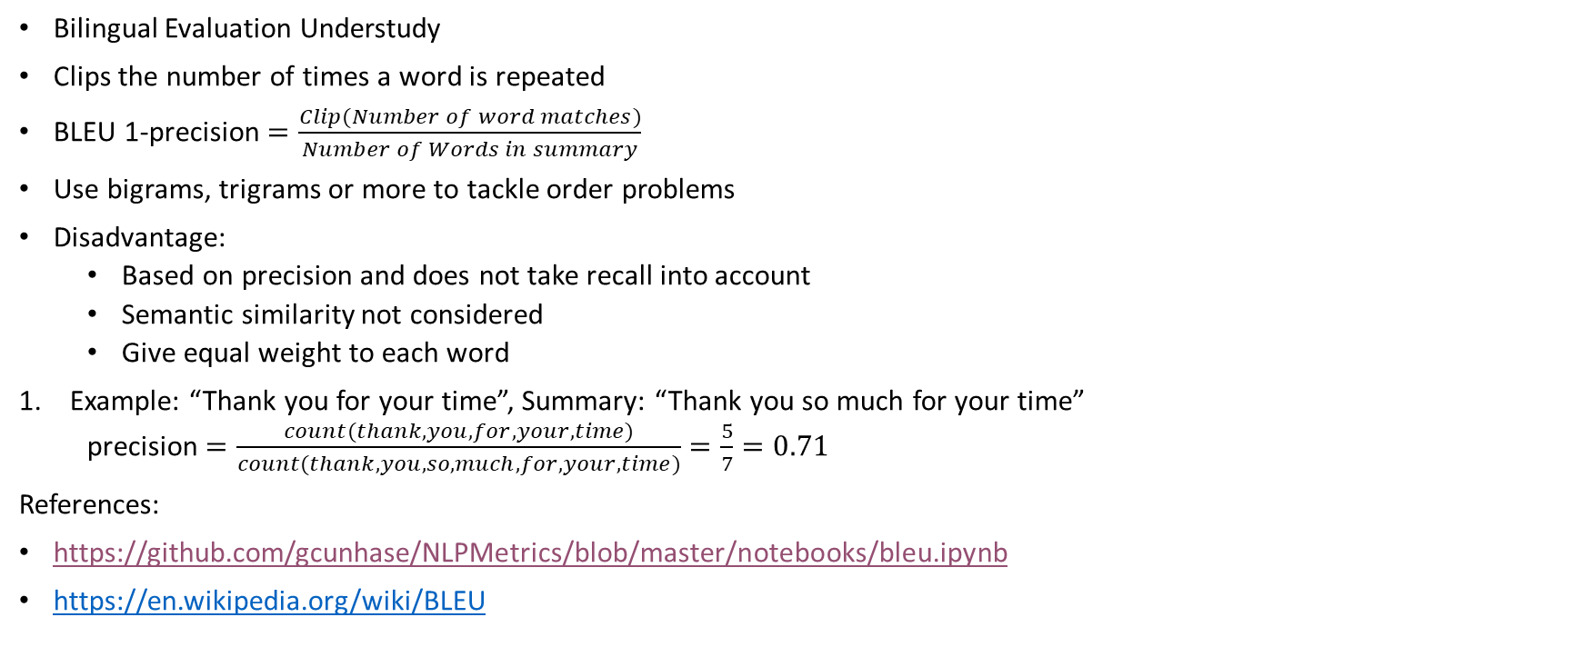
BLEU Metric
Bilingual Evaluation Understudy
Clips the number of times a word is repeated
BLEU 1-precision $=\frac{Clip(Number of word matches)}{Number of Words in summary}$
Use bigrams, trigrams or more to tackle order problems
Disadvantage:
Based on precision and does not take recall into account
Semantic similarity not considered
Give equal weight to each word
Example: “Thank you for your time”, Summary: “Thank you so much for your time”
precision $=\frac{count(thank, you,for, your, time)}{count(thank, you, so, much, for, your, time)}=\frac{5}{7}=0.71$
References:
https://github.com/gcunhase/NLPMetrics/blob/master/notebooks/bleu.ipynb
https://en.wikipedia.org/wiki/BLEU

Slide 3
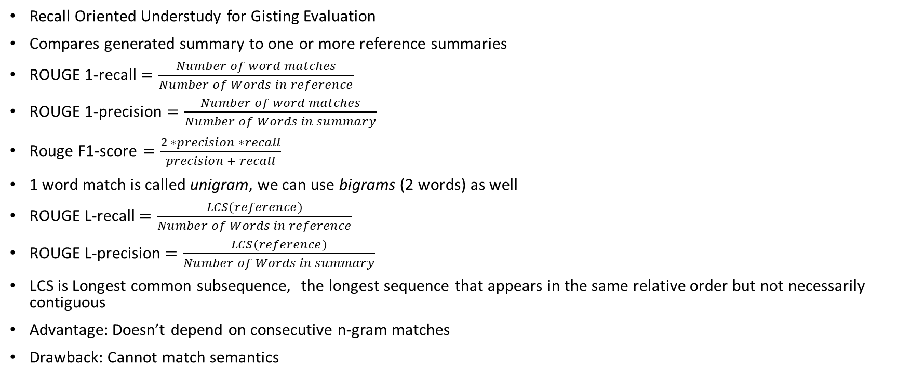
ROUGE Metric
Recall Oriented Understudy for Gisting Evaluation
Compares generated summary to one or more reference summaries
ROUGE 1-recall $=\frac{Number of word matches}{Number of Words in reference}$
ROUGE 1-precision $=\frac{Number of word matches}{Number of Words in summary}$
$\text{Rouge} \text{F}\text{1−}\text{score}=\frac{2 ∗precision ∗recall}{precision + recall}$
1 word match is called unigram, we can use bigrams (2 words) as well
ROUGE L-recall $=\frac{LCS(reference)}{Number of Words in reference}$
ROUGE L-precision $=\frac{LCS(reference)}{Number of Words in summary}$
LCS is Longest common subsequence, the longest sequence that appears in the same relative order but not necessarily contiguous
Advantage: Doesn’t depend on consecutive n-gram matches
Drawback: Cannot match semantics

Slide 4
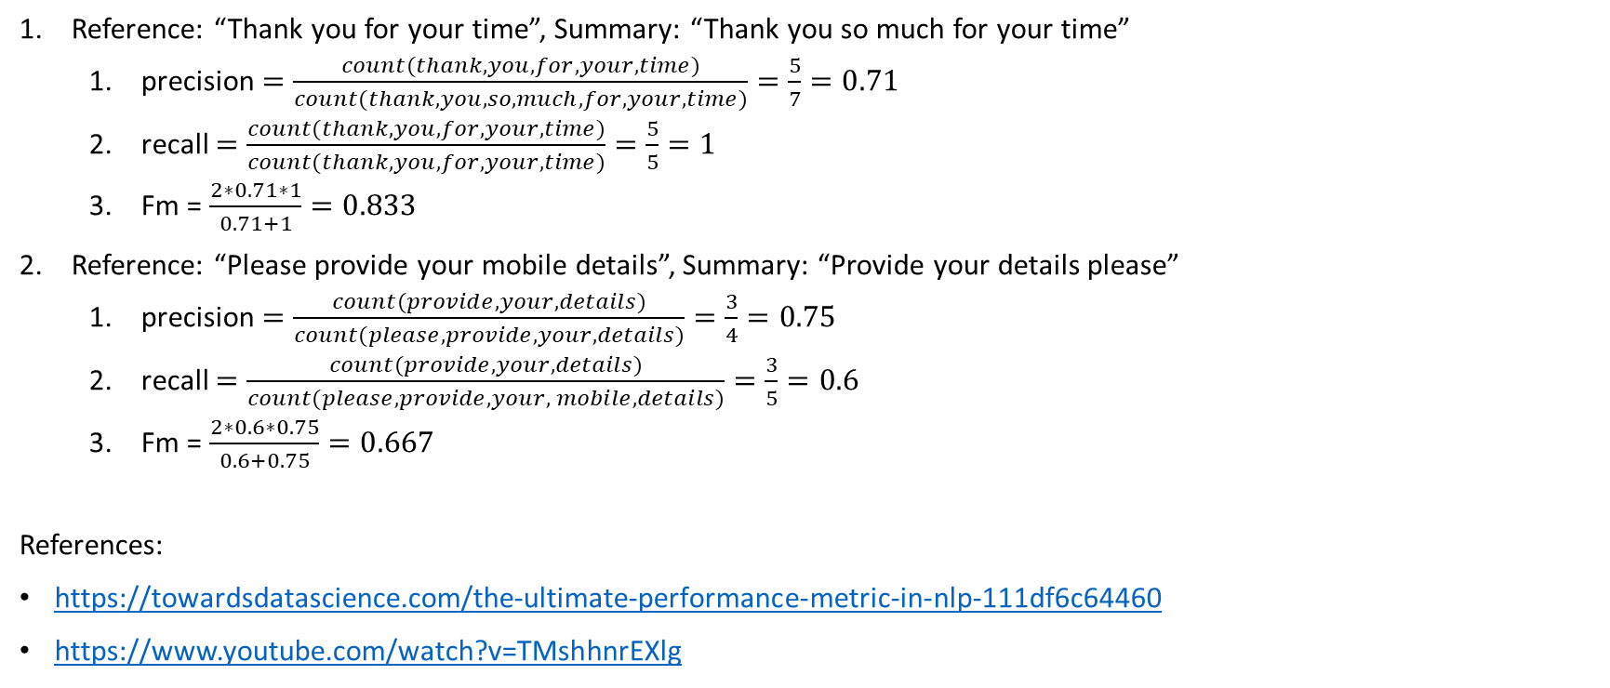
Examples
Reference: “Thank you for your time”, Summary: “Thank you so much for your time”
precision $=\frac{count(thank, you,for, your, time)}{count(thank, you, so, much, for, your, time)}=\frac{5}{7}=0.71$
recall $=\frac{count(thank, you,for, your, time)}{count(thank, you, for, your, time)}=\frac{5}{5}=1$
Fm = $\frac{2∗0.71∗1}{0.71+1}=0.833$
Reference: “Please provide your mobile details”, Summary: “Provide your details please”
precision $=\frac{count(provide, your, details)}{count(please, provide, your, details)}=\frac{3}{4}=0.75$
recall $=\frac{count(provide, your, details)}{count(please, provide, your, mobile, details)}=\frac{3}{5}=0.6$
Fm = $\frac{2∗0.6∗0.75}{0.6+0.75}=0.667$
References:
https://towardsdatascience.com/the-ultimate-performance-metric-in-nlp-111df6c64460
https://www.youtube.com/watch?v=TMshhnrEXlg

Slide 5
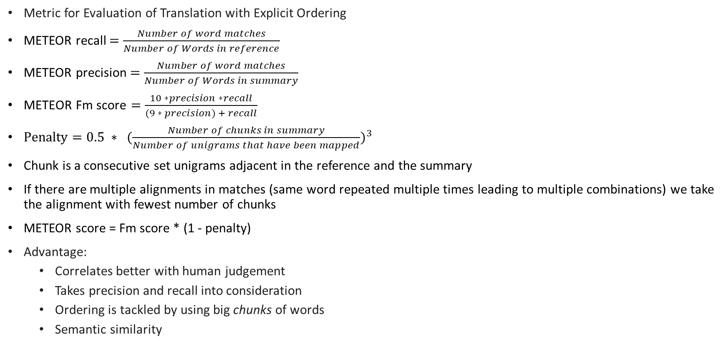
METEOR Metric
Metric for Evaluation of Translation with Explicit Ordering
METEOR recall $=\frac{Number of word matches}{Number of Words in reference}$
METEOR precision $=\frac{Number of word matches}{Number of Words in summary}$
$\text{METEOR} \text{Fm} \text{score}=\frac{10 ∗precision ∗recall}{(9 ∗ precision) + recall}$
$Penalty=0.5 ∗ ({\frac{Number of chunks in summary}{Number of unigrams that have been mapped})}^{3}$
Chunk is a consecutive set unigrams adjacent in the reference and the summary
If there are multiple alignments in matches (same word repeated multiple times leading to multiple combinations) we take the alignment with fewest number of chunks
METEOR score = Fm score * (1 - penalty)
Advantage:
Correlates better with human judgement
Takes precision and recall into consideration
Ordering is tackled by using big chunks of words
Semantic similarity

Slide 6
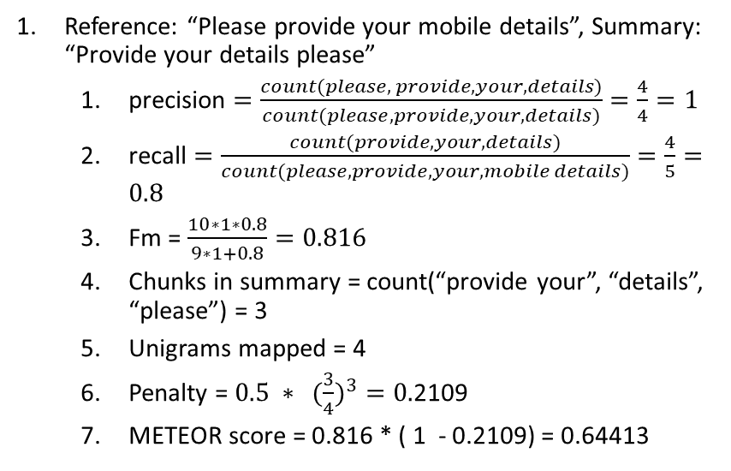
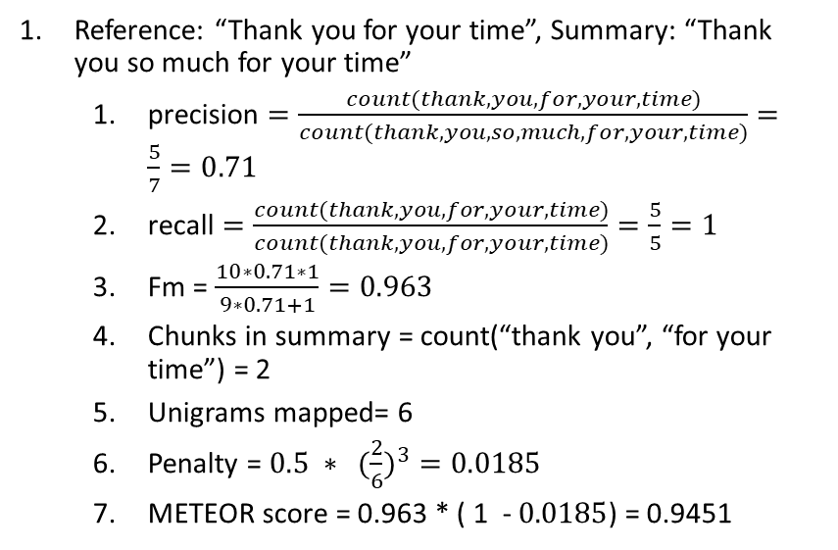
Examples
Reference: “Thank you for your time”, Summary: “Thank you so much for your time”
precision $=\frac{count(thank, you,for, your, time)}{count(thank, you, so, much, for, your, time)}=\frac{5}{7}=0.71$
recall $=\frac{count(thank, you,for, your, time)}{count(thank, you, for, your, time)}=\frac{5}{5}=1$
Fm = $\frac{10∗0.71∗1}{9∗0.71+1}=0.963$
Chunks in summary = count(“thank you”, “for your time”) = 2
Unigrams mapped= 6
Penalty = $0.5 ∗ ({\frac{2}{6})}^{3}=0.0185$
METEOR score = 0.963 * ( 1 - $0.0185$) = 0.9451
Reference: “Please provide your mobile details”, Summary: “Provide your details please”
precision $=\frac{count(please, provide, your, details)}{count(please, provide, your, details)}=\frac{4}{4}=1$
recall $=\frac{count(provide, your, details)}{count(please, provide, your, mobile details)}=\frac{4}{5}=0.8$
Fm = $\frac{10∗1∗0.8}{9∗1+0.8}=0.816$
Chunks in summary = count(“provide your”, “details”, “please”) = 3
Unigrams mapped = 4
Penalty = $0.5 ∗ ({\frac{3}{4})}^{3}=0.$2109
METEOR score = 0.816 * ( 1 - 0.2109) = 0.64413
References:
https://en.wikipedia.org/wiki/METEOR
https://youtu.be/FqQbrlEh_b0

Slide 7
NIST Metric
https://en.wikipedia.org/wiki/NIST_(metric)

Slide 8
Chatbot-related Metrics
ENT/Entropy score
DIST/Distinct score

